Slide 1

IMAGE CLASSIFICATION
Group 8
Anirudh Pal(22040)
Vipul Sharma(22369)
Sundram Anand (22342)
Gargi Sujit Pande(22127)

Slide 2

RANDOM FOREST
Anirudh Pal (22040)

Slide 3
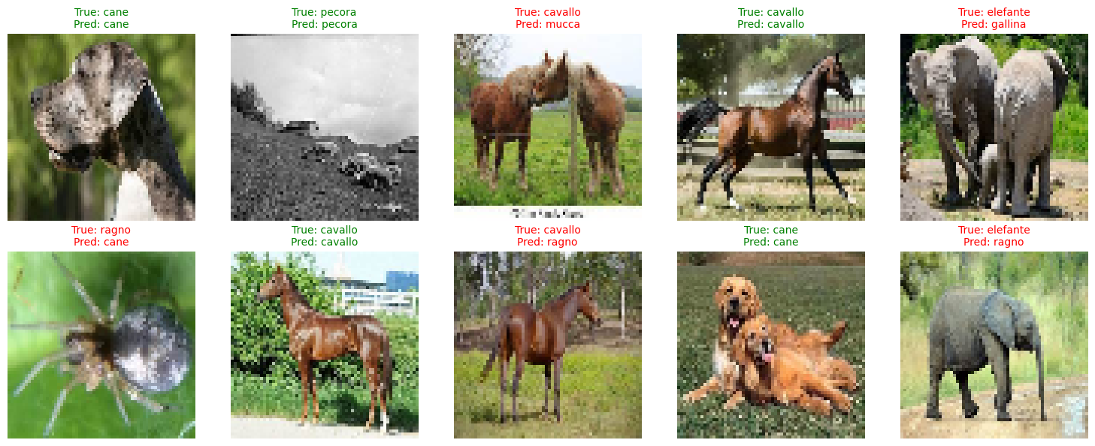
CAN IT CLASSIFY
Does it classify the images correctly , and how accurately ?

Slide 4
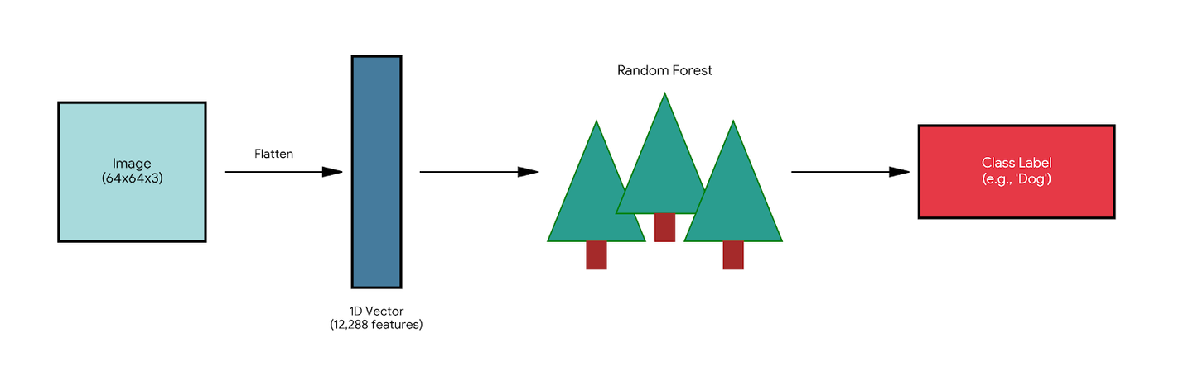
METHODOLOGY
Input Data: Custom 10 class animal dataset.
Preprocessing: Flattened 2D images into 1D vectors.
Feature Space: 12,288 independent pixel features per image.
Model: Random Forest Classifier (100 Estimators).
Core Assumption: Can the model learn to classify objects based solely on pixel intensity patterns?

Slide 5
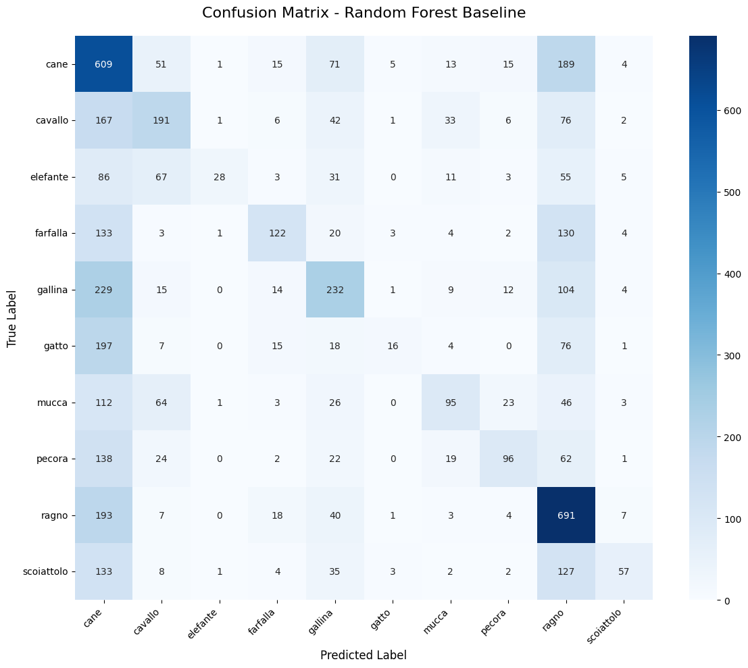
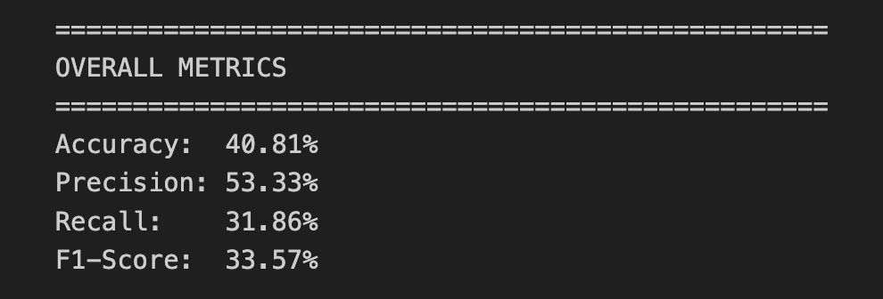
OVERALL PERFORMANCE
The Confusion matrix shows that the accuracy ,precision, recall and F1-score wasn’t good.
(The values of the evaluation metrics )

Slide 6
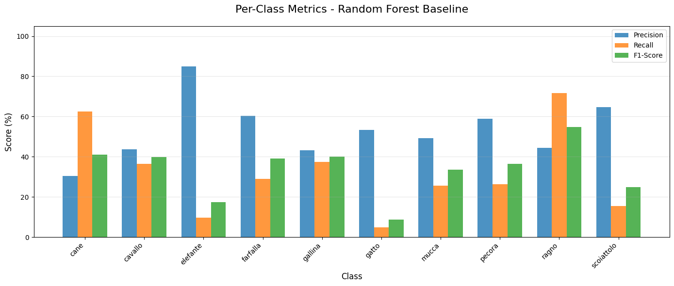
CLASS-SPECIFIC BREAKDOWN
The "Easy" Classes: Ragno (Spider) and Cane (Dog) show the highest accuracy (Recall > 60%).
The "Hard" Classes: Gatto (Cat) and Scoiattolo (Squirrel) are near total failure (< 15% Accuracy).
The model struggles to differentiate between animals with similar textures (e.g., Cow vs. Horse) because it cannot see the body shape.

Slide 7
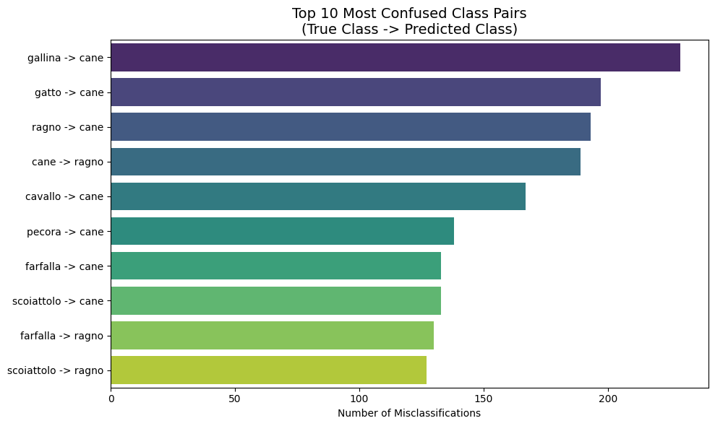
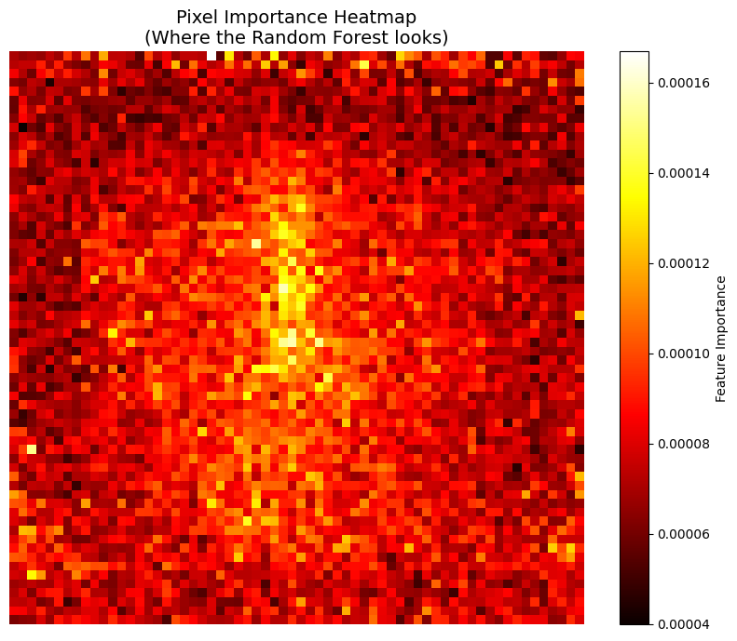
WHY IT FAILS
The model most frequently confuses Cane (Dog) with Gallina (Hen) and on 2nd most Gatto (Cat) with Cane (Dog)
The heatmap on the right proves the model only looks at the center of the image
It completely misses critical features like legs, ears, or tails (the edges).

Slide 8
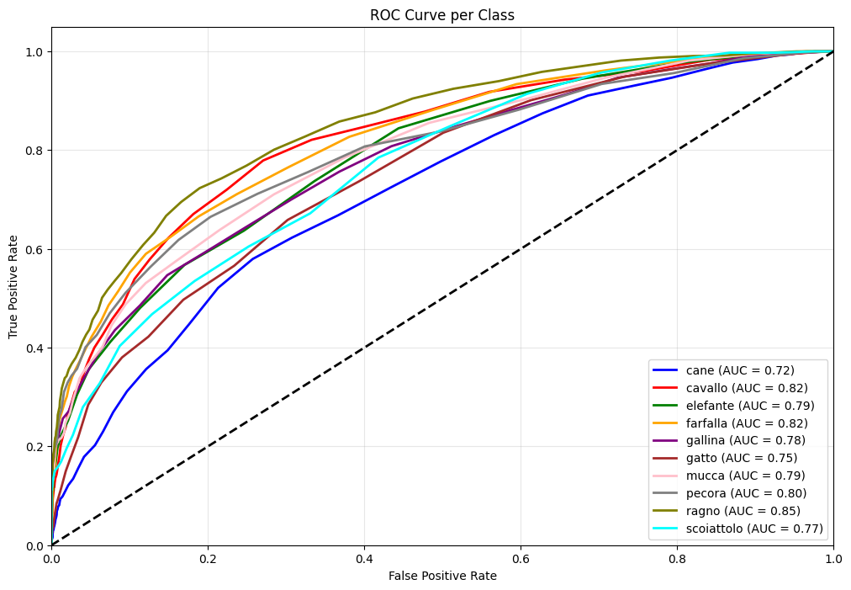
AUC ANALYSIS
Low Area Under Curve (AUC): Most classes likely hover between 0.60 and 0.70 (where 0.50 is random guessing)
High False Positive Cost: To achieve a high True Positive Rate (e.g., catching 80% of the dogs), the curve shows we would accept a massive False Positive Rate.
The curves for difficult classes (like Gatto/Cat) are closer to the diagonal line.

Slide 9
CONCLUSION
Critical Findings:
Random Forests cannot learn complex image structures from raw pixels alone (Accuracy stuck at ~40%).
The model lacks Spatial Invariance—it sees color intensity but misses shape, hierarchy, and texture.
Better data representation (Features) is more important than a complex model.
Future Direction: To achieve human-level accuracy, we must move to Convolutional Neural Networks (CNNs)

Slide 10
IMAGE CLASSIFICATION USING CNN
GARGI PANDE (22127)

Slide 11
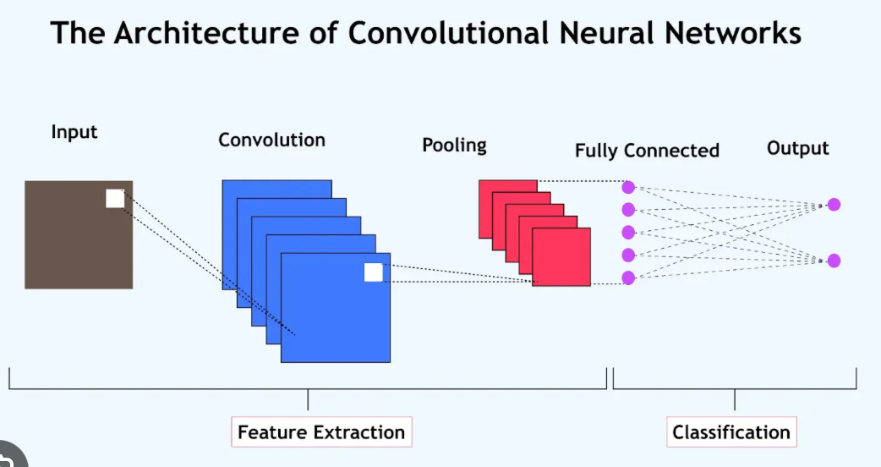
HOW DOES IT WORK?
A Convolutional Neural Network (CNN) works by applying a series of convolutional layers to an input image, automatically learning hierarchical features like edges and patterns, followed by pooling and fully connected layers to classify the image based on learned features.

Slide 12
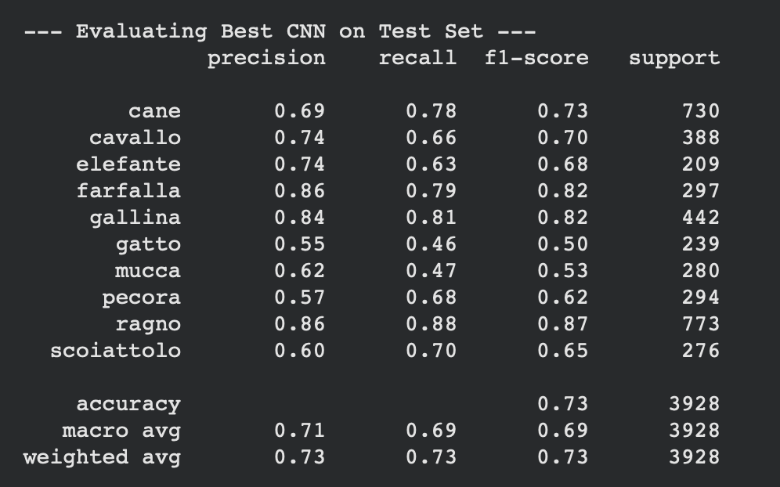
OVERALL PERFORMANCE OF THE CNN MODEL
Farfalla (Butterfly) and Ragno (Spider) are the best performers, with high precision, recall, and f1-scores.
Gatto (Cat) has the lowest performance across precision, recall, and f1-score, indicating that the model struggles to classify cats correctly.
Class Imbalance might be affecting performance, especially for classes like Gatto, which have lower scores.
The weighted average is slightly higher than the macro average, suggesting the model is performing better on classes with higher support.

Slide 13
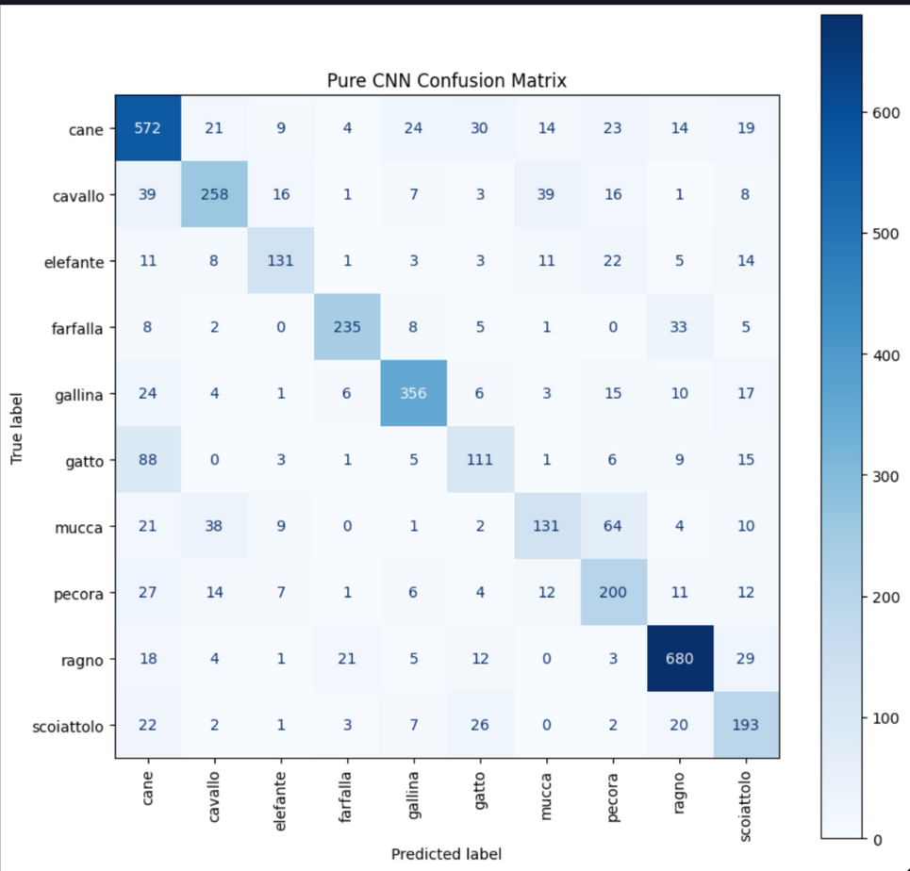
CONFUSION MATRIX OF THE CNN MODEL

Slide 14
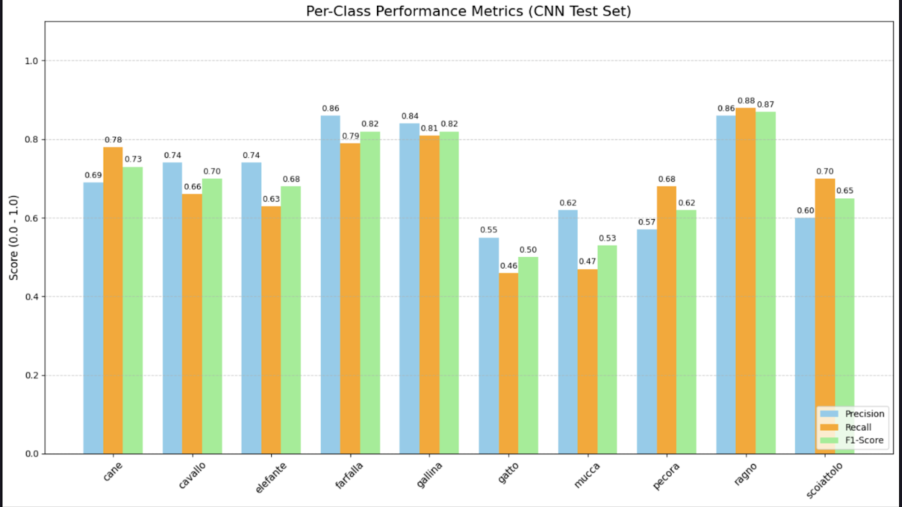
CLASS BASED PERFORMANCE

Slide 15
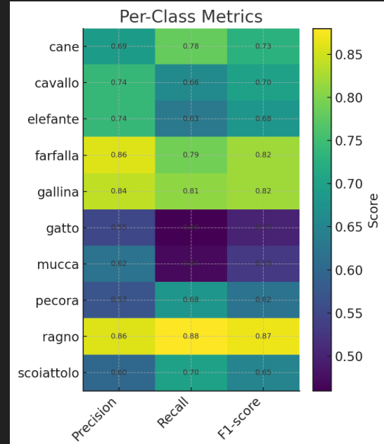
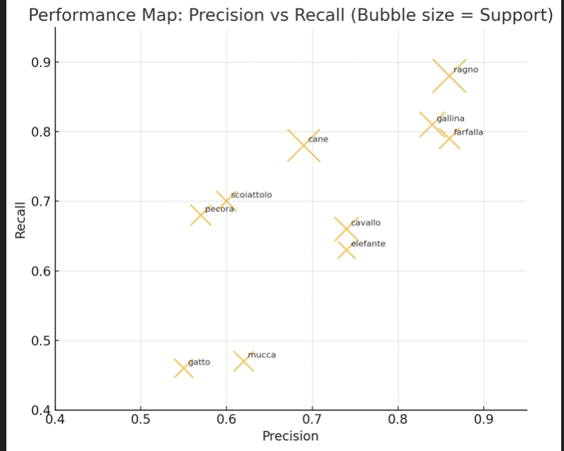
TO UNDERSTAND PERFORMANCE BY CLASS

Slide 16
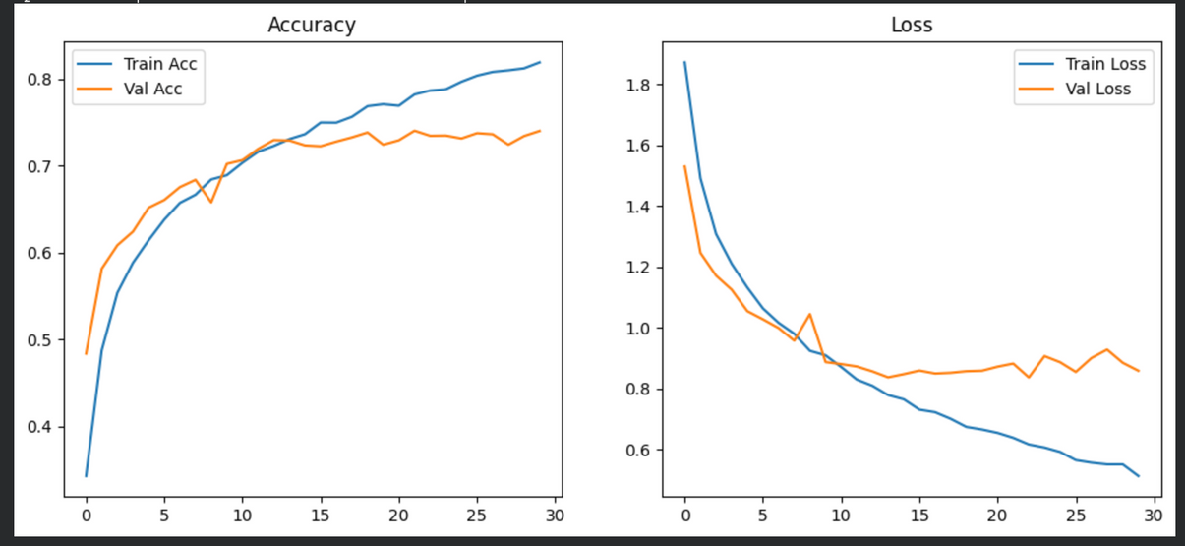
TRAINING AND VALIDATION METRICS
.
Validation Accuracy:
The validation accuracy also improves initially but starts to level off around epoch 15.
Indicates that the model may be starting to overfit and struggle to generalize to unseen data.
Validation Loss:
The validation loss starts high but decreases initially, then begins to rise slightly after epoch 10.
The increasing validation loss after epoch 10 further supports the overfitting issue, as the model is memorizing the training data but not generalizing well on the validation set.
While the model performs well on training data (high accuracy, low loss), it shows signs of overfitting by failing to generalize to new data.

Slide 17
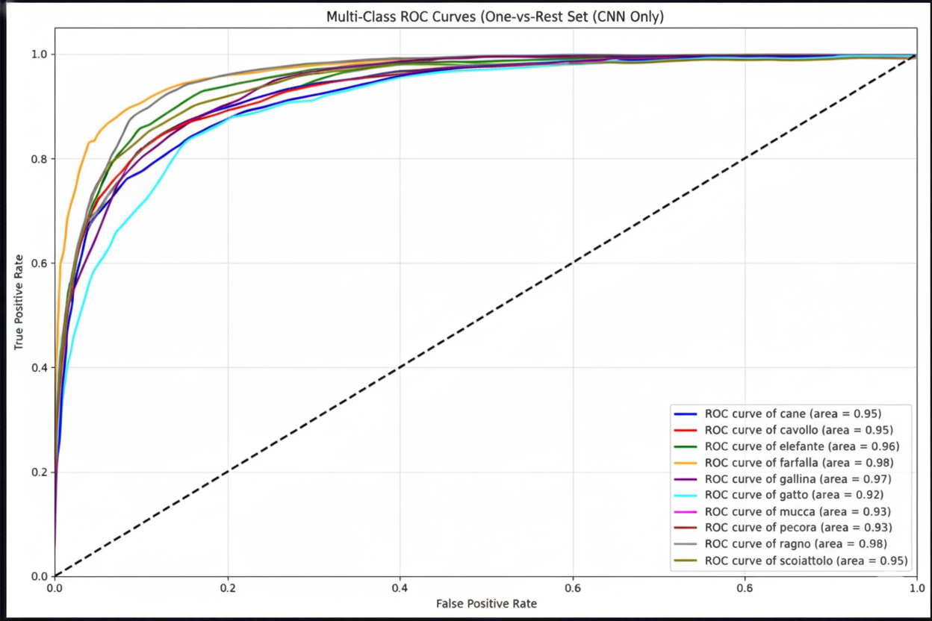
ANALYSIS OF ROC CURVE
The model is generally performing well for most classes with AUCs above 0.90.
There is a clear discrepancy in performance, where certain classes (like Ragno, Farfalla) are easily distinguishable, while others (like Gatto, Mucca) are more challenging for the model.
The model is stronger in differentiating between visually or contextually distinct classes (like Ragno and Farfalla) than those that might have more similarities in features (e.g., Gatto vs Cane).

Slide 18
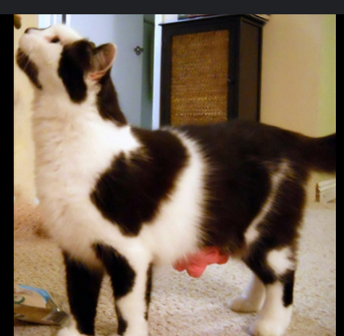
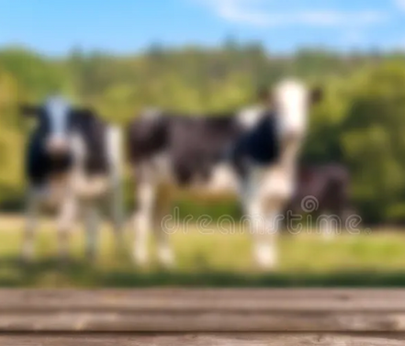
LIMITATIONS WITH CNN
While CNNs are great at learning hierarchical features, they may still struggle if the visual features in the dataset are not distinct enough or the image quality is not optimal. The netCNNs generally perform well with distinct objects, but subtle differences between classes (like cats and cows) can challenge the model, especially if it has a simpler architecture or hasn’t been tuned well for these types of subtleties.
The model might not be complex enough to capture the more nuanced differences between these two classes.

Slide 19
IMAGE CLASSIFICATION USING HYBRID CNN + RANDOM FOREST
VIPUL SHARMA(22369)

Slide 20
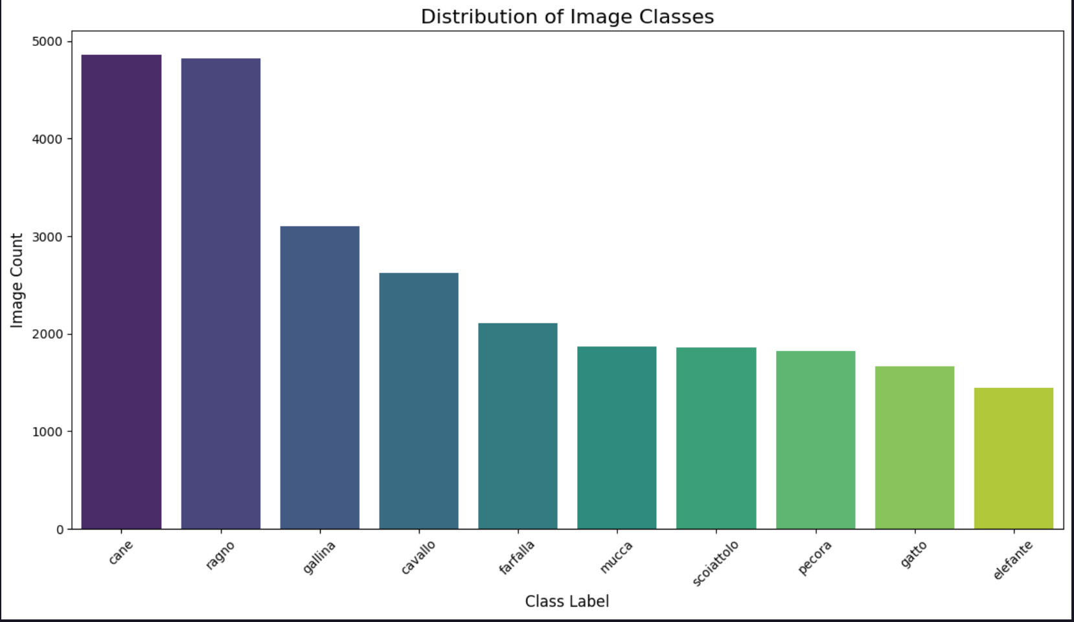
Objective: Classify images into 10 distinct animal categories (Cane, Cavallo, Elefante, Farfalla, Gallina, Gatto, Mucca, Pecora, Ragno, Scoiattolo).
Observation: The dataset is Imbalanced
Strategy: Using stratified splitting (Train/Val/Test) to ensure all classes are represented during training.

Slide 21
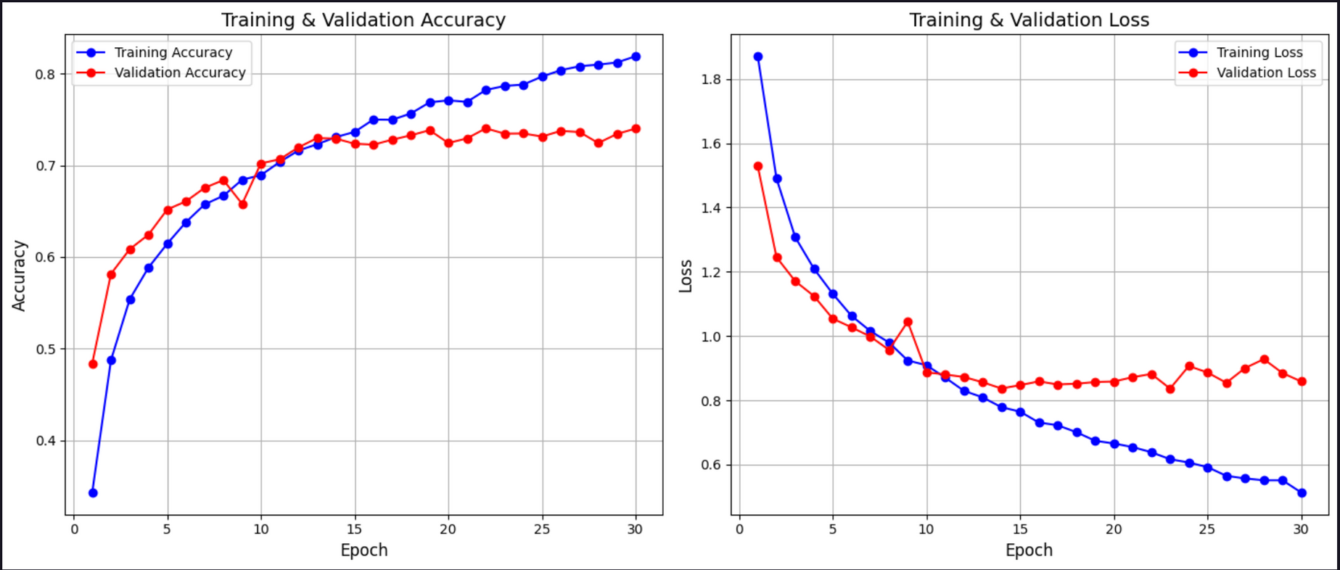
Accuracy: The Training Accuracy keeps climbing to over 80%, but the Validation Accuracy plateaus around 74%. This gap indicates Overfitting. The model is memorizing the training data but struggling to generalize to new data.
Loss: Training error dropped, while validation error stabilized after Epoch 15.
Outcome: The best model was saved for feature extraction.

Slide 22
Stage 1: Feature Extraction (CNN)
Input: Receives raw 150×150 RGB images.
Processing: Passes through 3 Convolutional Blocks (Conv2D + ReLU + MaxPool) to learn spatial patterns like edges and textures.
Vectorization: A Flatten Layer converts the 3D maps into a 1D vector (41,472 units).
Output: A fully connected Dense Layer compresses this into a rich 512-dimensional feature vector.
Stage 2: Classification (Random Forest)
Input: Takes the 512 numeric features extracted by the CNN.
Logic: An ensemble of 100 Decision Trees analyzes these features.
Result: The final class label is decided by a majority vote among the trees.

Slide 23
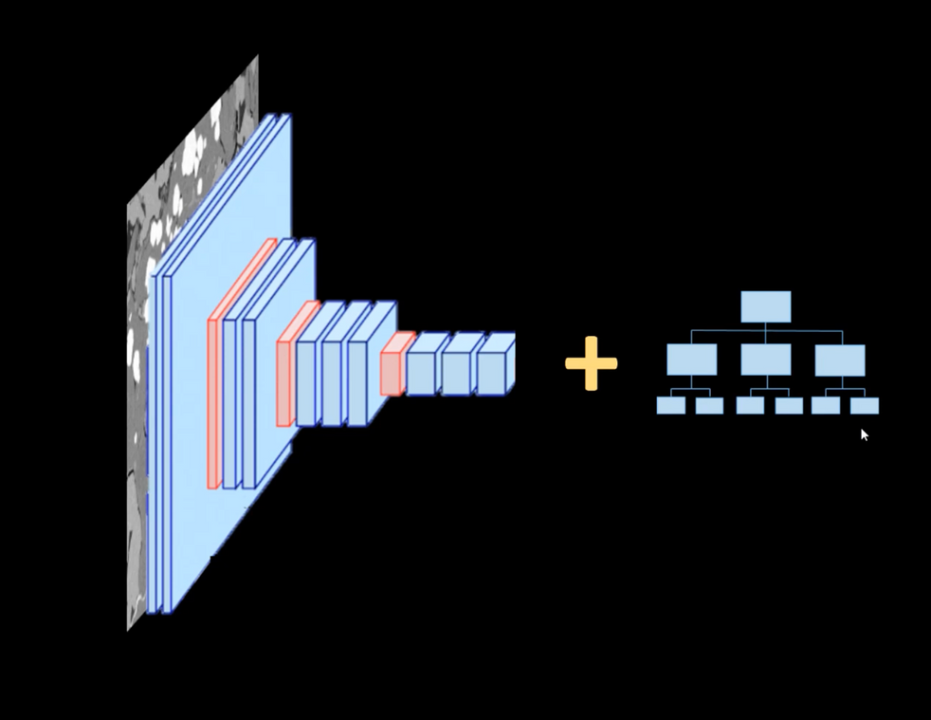
The Architecture:
Feature Extractor (CNN): A Convolutional Neural Network processes raw images to detect edges, textures, and patterns. We remove the final "Dense" layers.
Classifier (Random Forest): The extracted features (vectors of 512 numbers) are fed into a Random Forest for the final decision.
Why this approach?
Prevents Overfitting: Avoids standard CNN dense layers, which often memorize small datasets.
Increases Robustness: Random Forest ensembles generalize better by averaging predictions from multiple trees.

Slide 24

Confusions:
Gatto (Cat) vs. Cane (Dog): There is noticeable confusion between these two (e.g., 106 cats predicted as dogs), likely due to similar body shapes and fur textures.
Mucca (Cow) vs. Pecora (Sheep): Some overlap exists here, likely due to grazing backgrounds

Slide 25
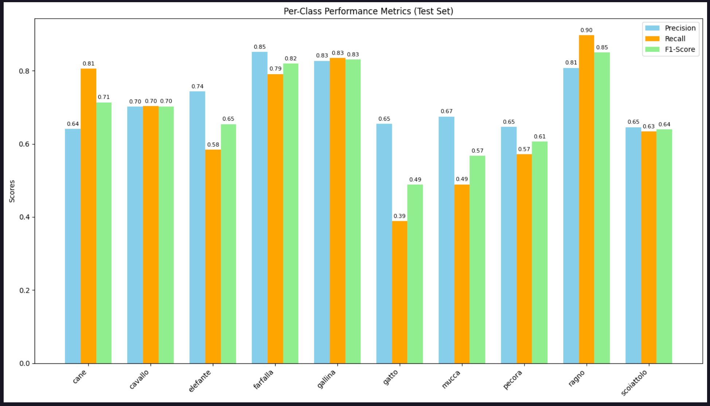

Slide 26
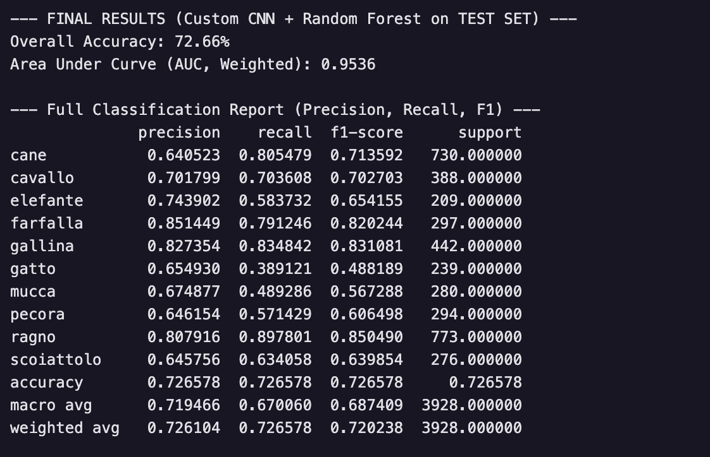
Best Performer: 'Farfalla' (Butterfly) and 'Ragno' (Spider) have the highest scores (F1 > 0.80). Their visual features (wings, many legs) are distinct from mammals.
Weakest Performer: 'Gatto' (Cat) has low Recall (0.39), meaning the model misses identifying many actual cats.
Overall: The Random Forest achieved a 72.66% accuracy on the test set, which is a strong result given the class imbalance.

Slide 27
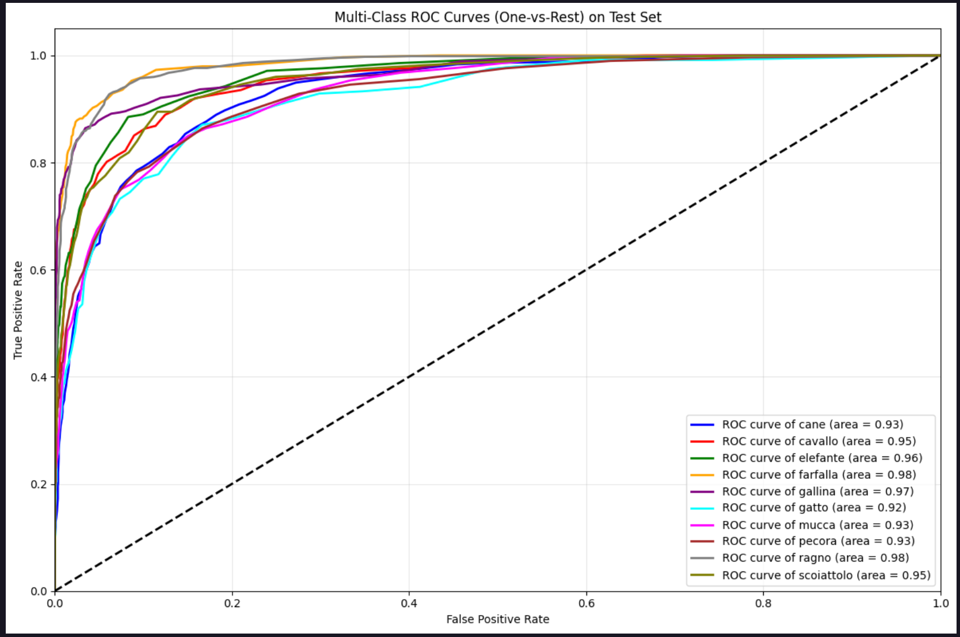
Analysis:
High AUC: All classes show an Area Under Curve (AUC) above 0.90.
Meaning: This indicates excellent class separability. Even if the model gets a specific label wrong (low recall on cats), it ranks the correct class very high in probability.
Conclusion:

Slide 28
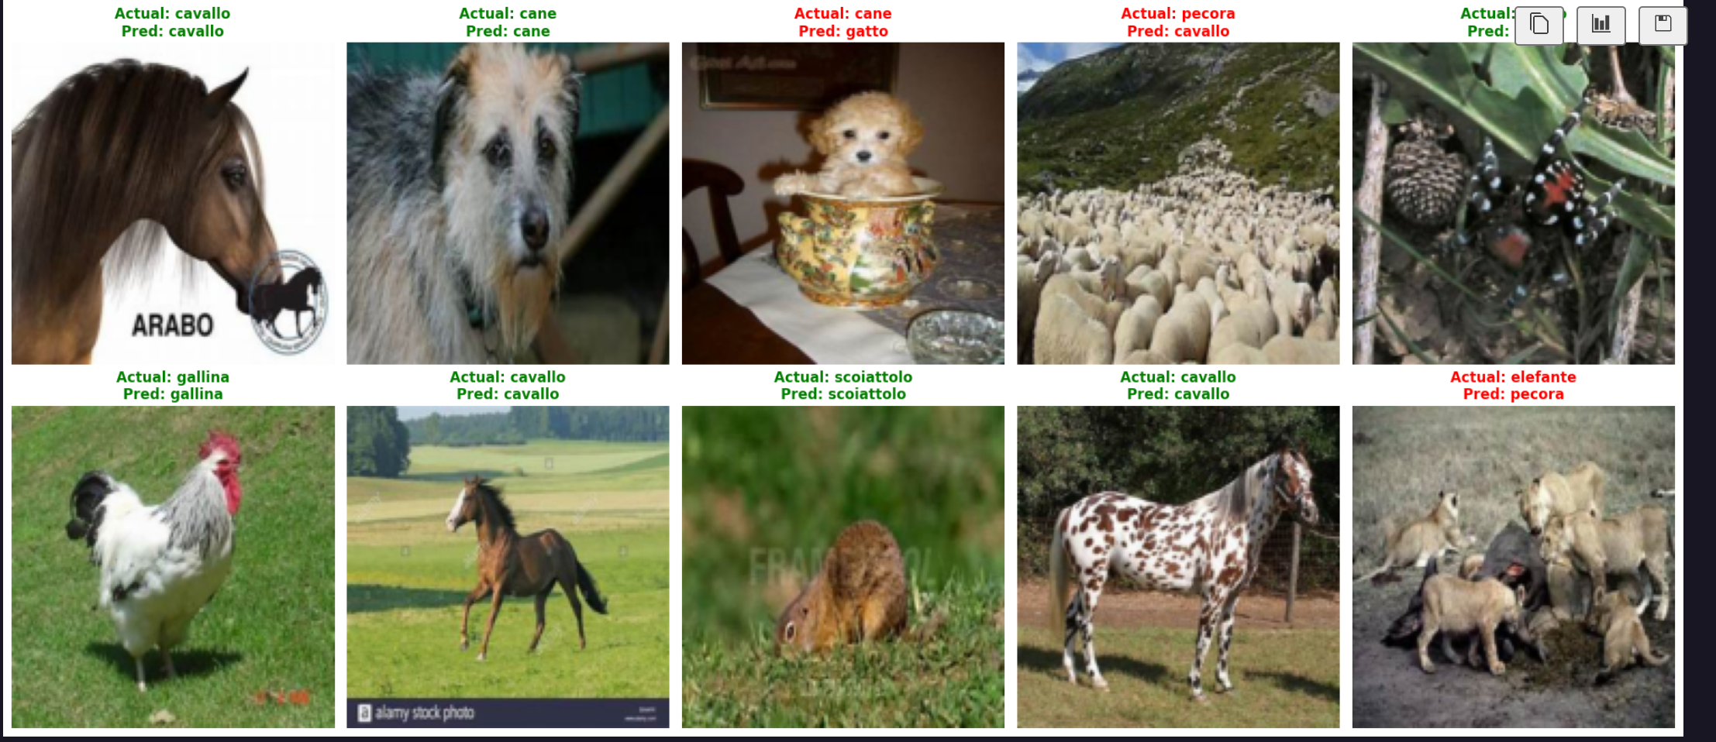
Robust Performance: Accurately identifies animals even with obstructions or tricky angles.
Strong Precision: Confidently classifies visually distinct creatures like spiders and elephants.

Slide 29
RESNET
Sundram Anand(22342)

Slide 30
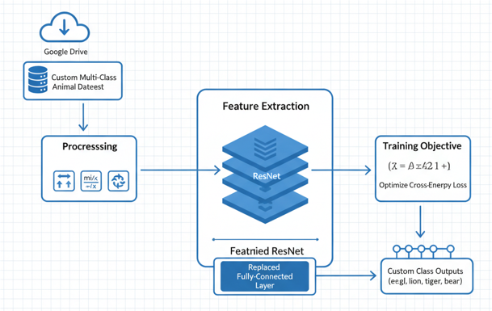
METHODOLOGY
Input Data: Custom multi-class animal dataset loaded from Google Drive.
Preprocessing: Applied resizing, normalization, and data augmentation using torchvision transforms.
Feature Extraction: Deep hierarchical features learned automatically by the pretrained ResNet backbone.
Model: Modified ResNet architecture with a replaced fully-connected layer for custom class outputs.
Training Objective: Optimize cross-entropy loss to learn discriminative visual patterns from images.
Core Question: Can the model accurately classify animals using learned feature representations instead of raw pixels?

Slide 31
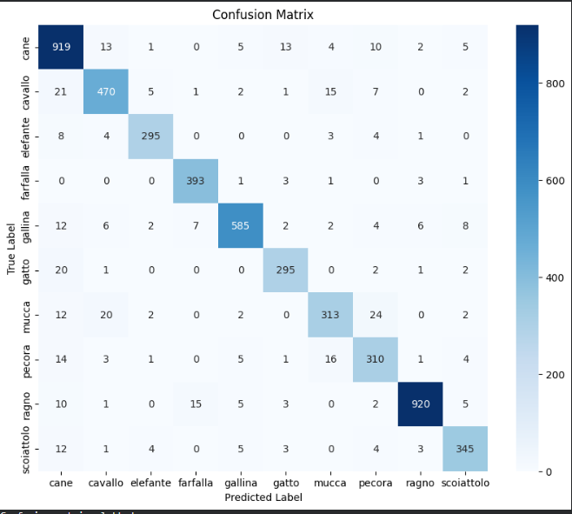
OVERALL PERFORMANCE
The performance is excellent. The model achieved a 92.5% validation accuracy, which is significantly higher than the baseline. It shows strong generalization across all 10 classes, with even the most difficult class (Cow) achieving over 80% accuracy.

Slide 32
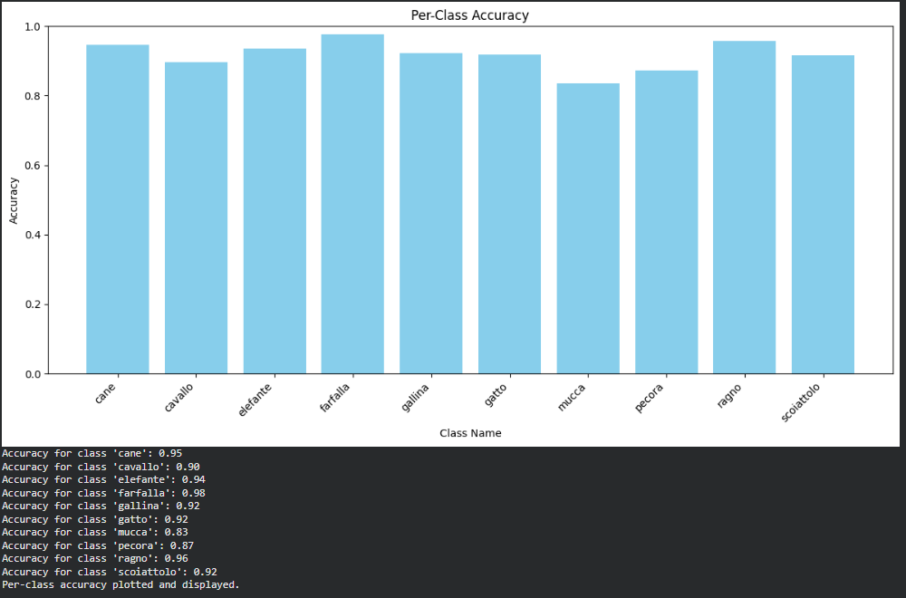
PER-CLASS ACCURACY
Most classes achieve high accuracy (above 90%), showing that the model is performing consistently well across the dataset.
‘Farfalla’ (0.98) and ‘Ragno’ (0.96) are the best-performing classes, indicating strong feature separability for these categories.
‘Mucca’ (0.83) and ‘Pecora’ (0.87) show relatively lower accuracy, suggesting that these classes may have more visual similarity or need additional training data.

Slide 33
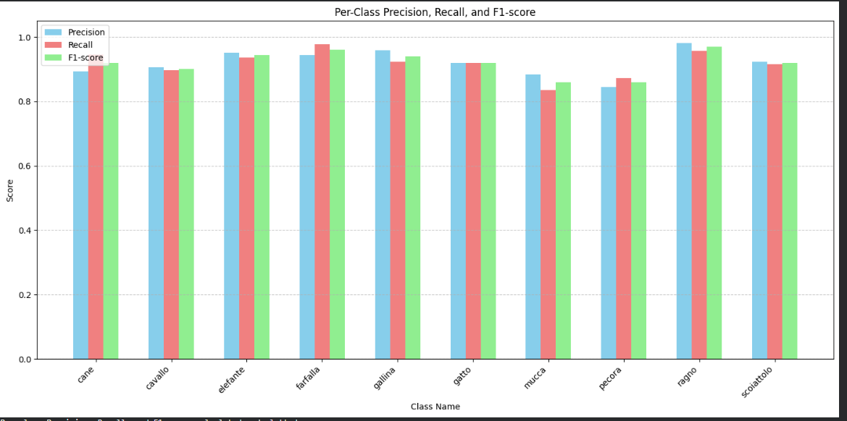
PER-CLASS PRECISION,RECALL, AND F1 SCORE
Most classes show high precision, recall, and F1-scores (mostly above 0.90), indicating strong and consistent performance.
Farfalla, ragno, and gallina perform the best across all metrics.
Mucca and pecora have slightly lower scores, suggesting these classes are more challenging to classify.
Overall, the model shows balanced behavior with minimal difference between precision, recall, and F1.

Slide 34
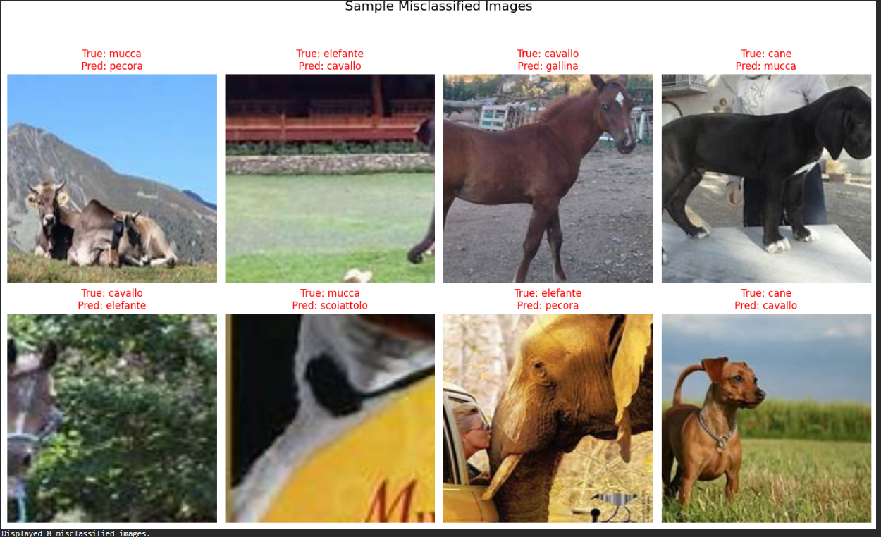
MISCLASSIFIED IMAGES
Many mistakes occur between visually similar classes (e.g., mucca–pecora, cavallo–elefante).
Cluttered backgrounds and complex scenes make classification harder.
Some errors are due to cropped, blurred, or partially visible animals.
The model sometimes relies too much on color/texture, causing confusion between look-alike classes.
Around 372 images were not classified, indicating possible data quality issues or model limitations.

Slide 35
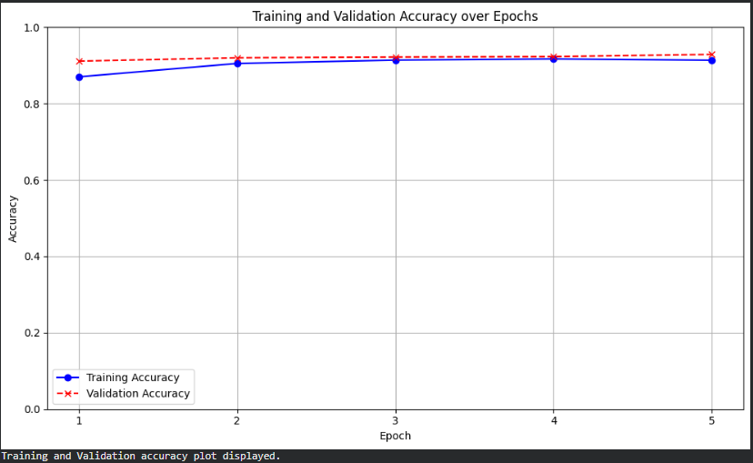
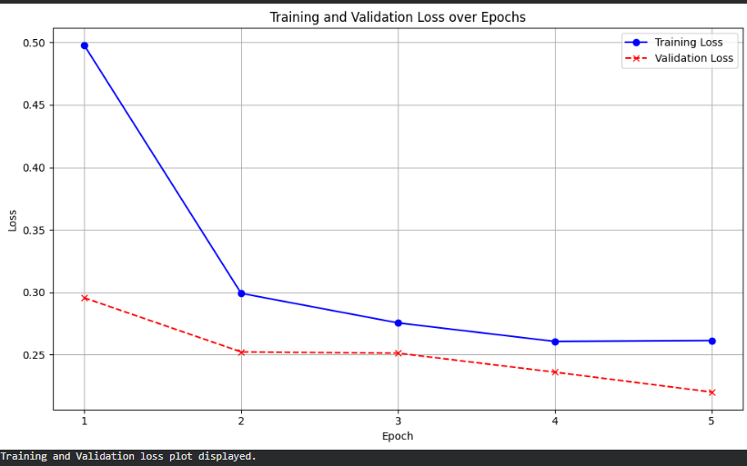
Training and Validation Accuracy/Loss over Epochs

Slide 36
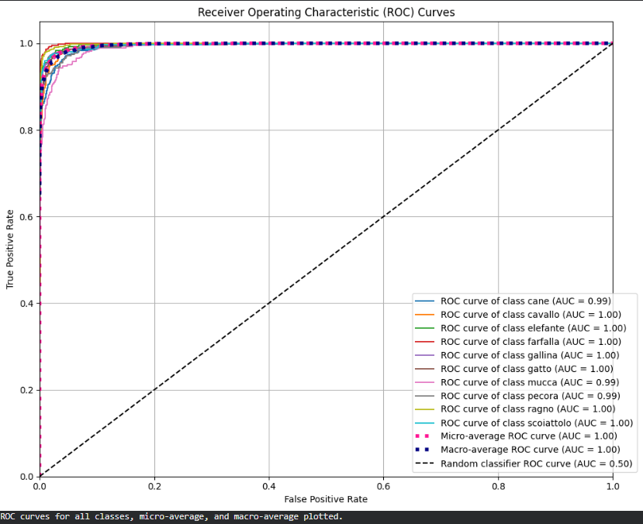
ROC CURVE
Most classes achieved AUC = 1.00, showing near-perfect classification.
A few classes have AUC = 0.99, still indicating very strong performance.
Micro and macro AUC = 1.00, confirming consistent results across all classes.
All ROC curves stay close to the top-left corner, far above the random baseline

Slide 37
CONCLUSION
The ResNet-based model achieved strong overall performance, with high precision, recall, and F1-scores across most classes.
Misclassifications primarily occurred between visually similar animals or images with poor quality or cluttered backgrounds.
ROC curves and AUC values close to 1.0 confirm that the model is highly effective at distinguishing between classes.
Further improvements can be made by enhancing data quality, increasing training data, and refining hyperparameters to reduce remaining errors.

Slide 38
THANK YOU

